Slide 1
Cotton disease prediction
Vineet Kumar(201599031)
Shreya Gupta(191500783)
Pawan Singh (201599017)

Slide 2
AGENDA
Cotton Disease Prediction
Introduction​
Gant Chart
​Coding Part
​Summary​

Slide 3
Introduction
Cotton is also called “White Gold” and “The King of Fibers. ” For growers, processors, exporters, and producing countries, cotton is the earnest point of supply. This work presents cotton plant disease detection using image processing techniques for an automated vision system used in agricultural fields. In agriculture research, automatic plant disease detection is essential in monitoring large fields of crops and thus automatically detects symptoms of the disease as soon as they appear on plant leaves.

Slide 4
Gantt chart
Cotton Disease Prediction
Work Flow Chart

Slide 5
TIMELINE
Project Design | September | October | November | December | January | February | March | April
Goal Identification
Project Approval
Get Dataset For project
Frontend Development
Backend Development
Testing
Deployment

Slide 6
Coding
Cotton Disease Prediction
Coding Part ML

Slide 7
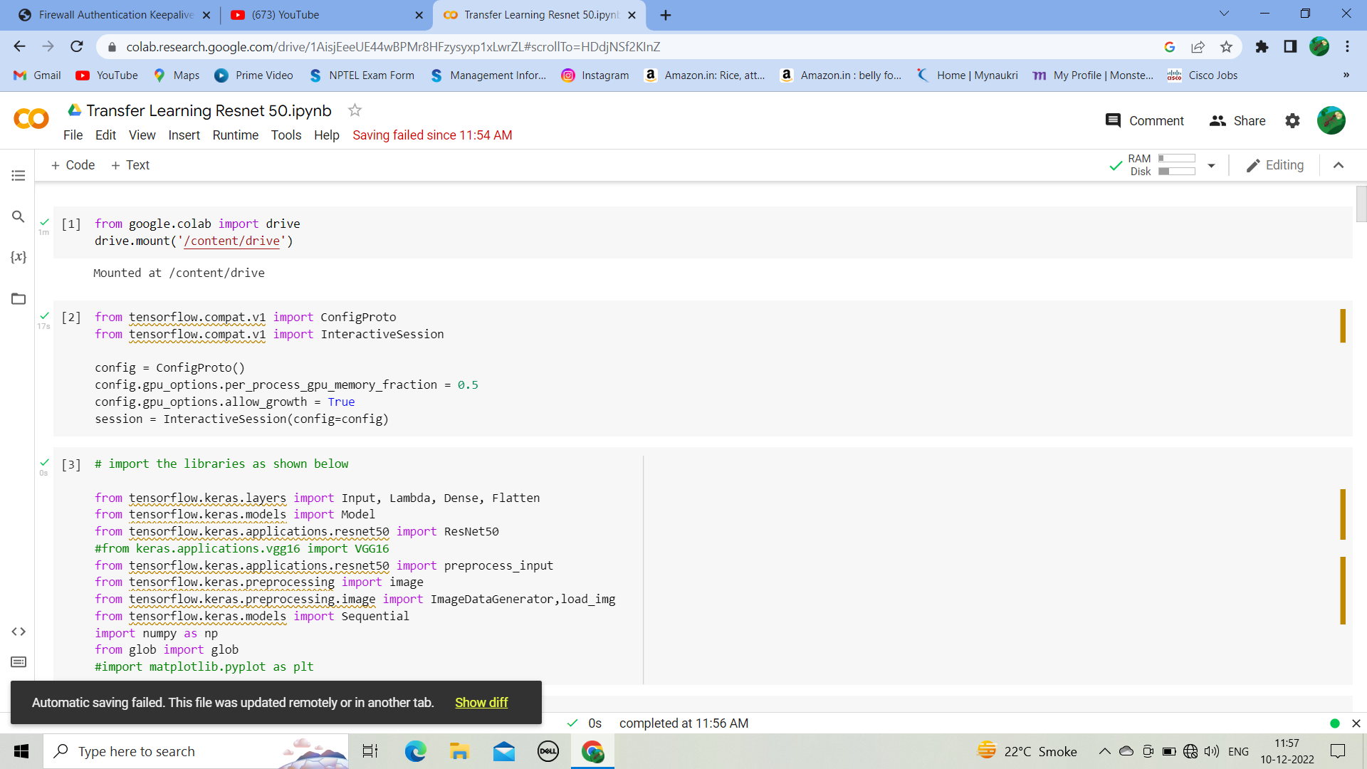

Slide 8
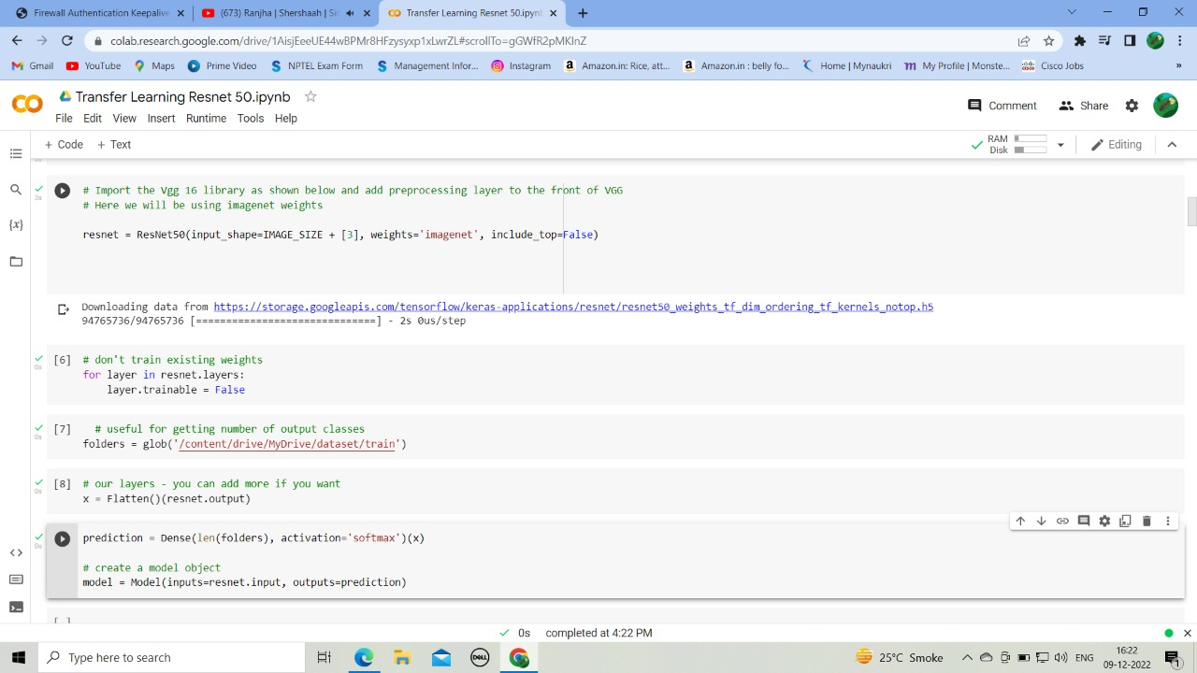

Slide 9
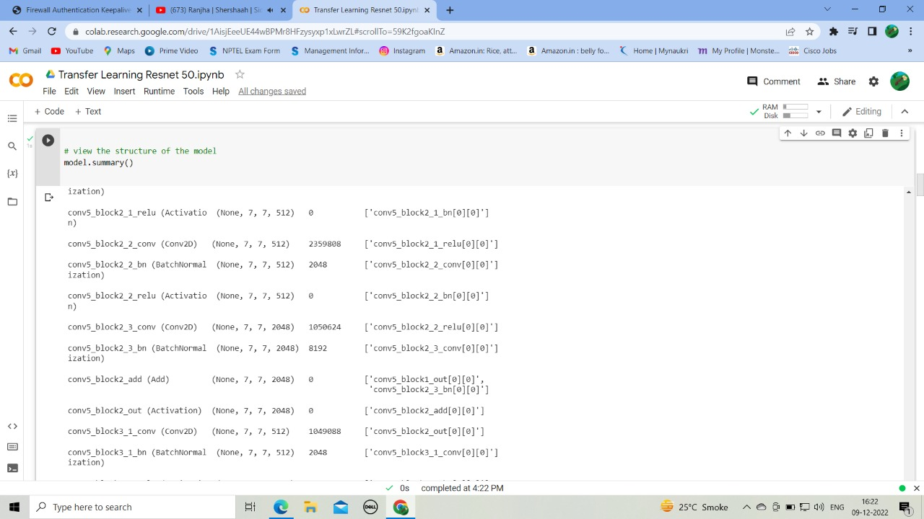

Slide 10
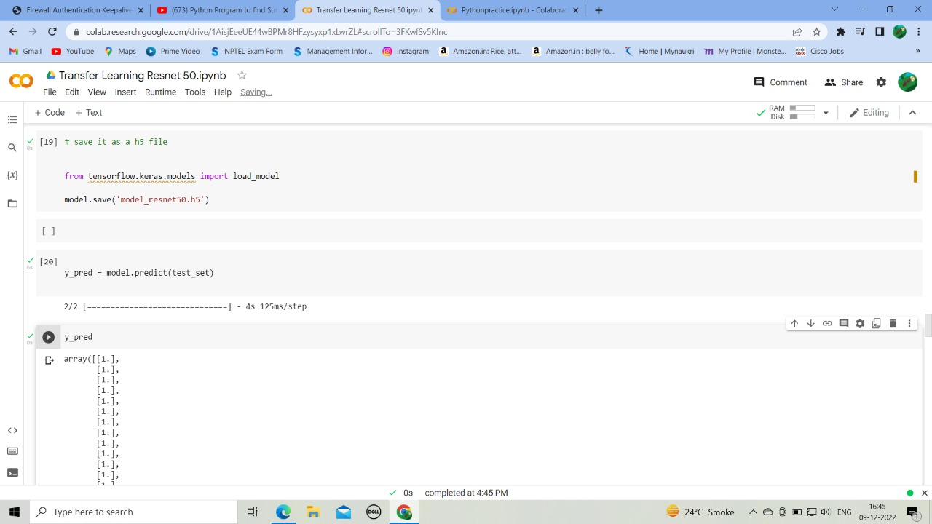

Slide 11
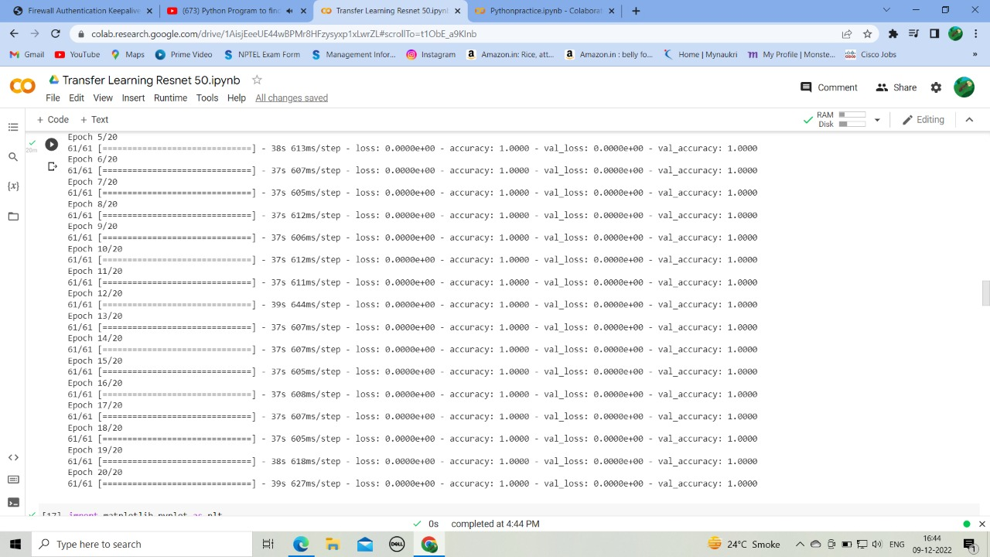

Slide 12
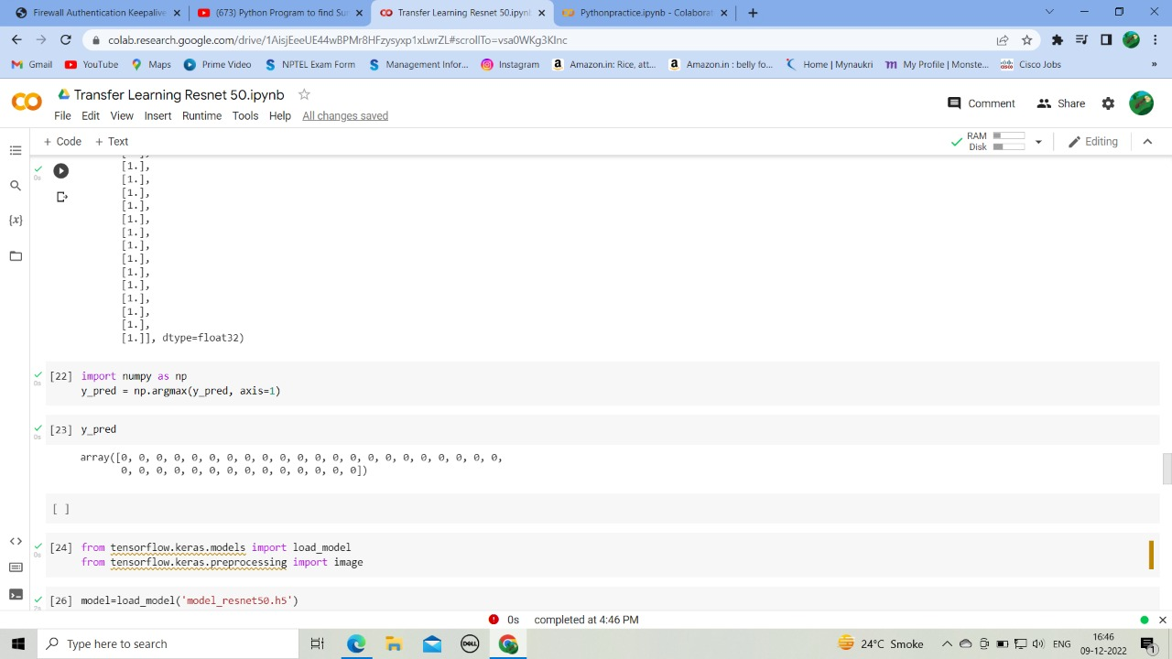

Slide 13
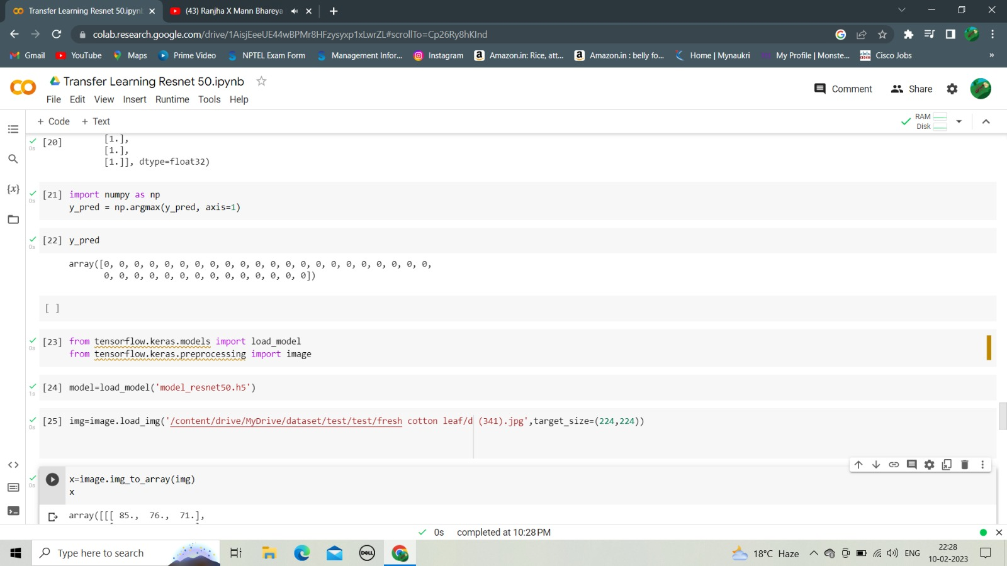

Slide 14
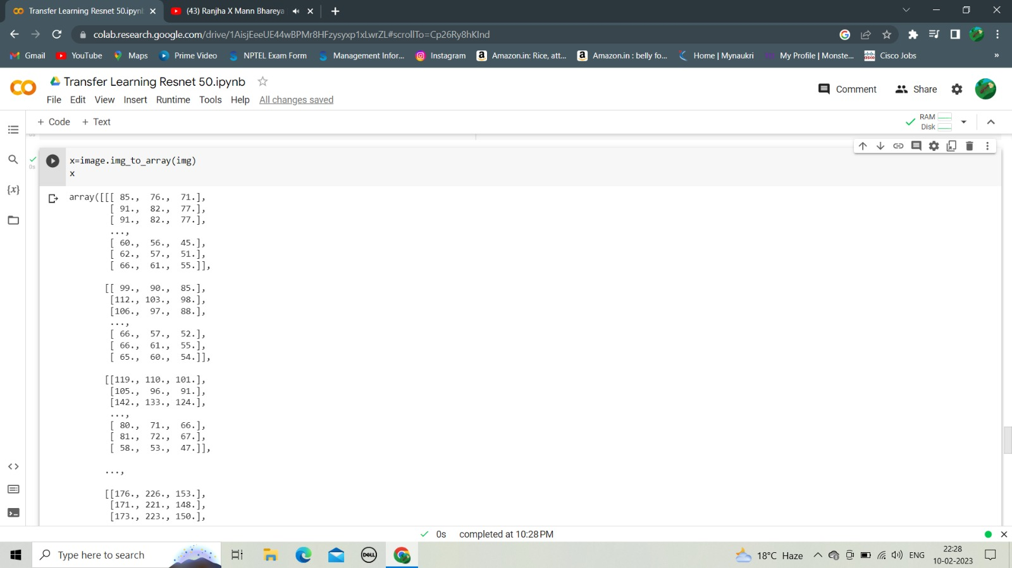

Slide 15
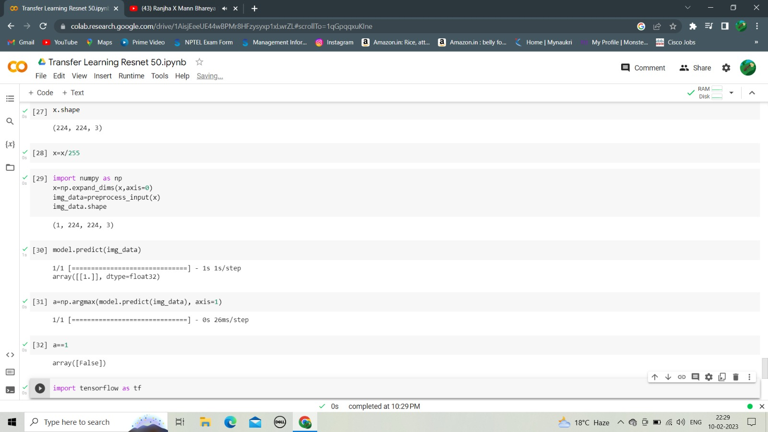

Slide 16
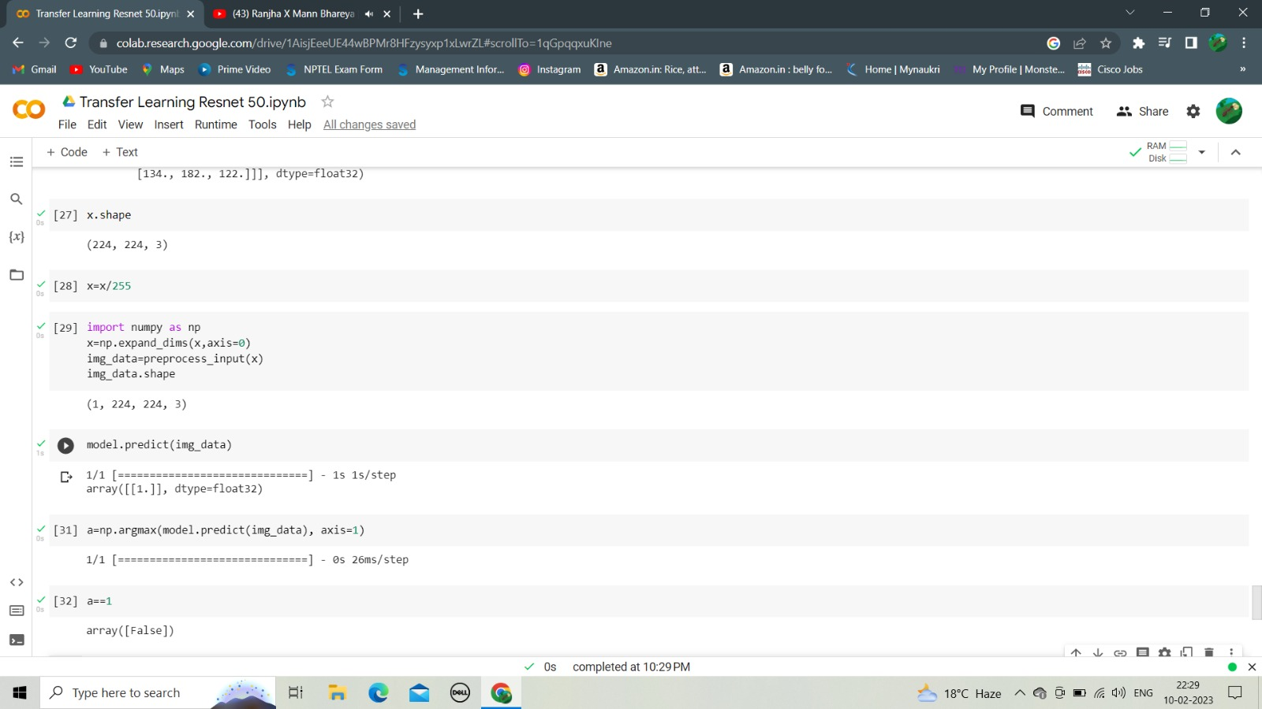

Slide 17
SUMMARY
At this point, we are ahead of time and we have finished the 60% of the project. Our next step is to complete the ML part and then induce that with Flask on the website.

Slide 18
THANK YOU
Cotton Disease Prediction
Vineet Kumar(201599031)
Shreya Gupta(191500783)
Pawan Singh (201599017)

